Slide 1


Sree Matangi.K
16/10/2025

Slide 2

Outline
Executive Summary
Introduction
Methodology
Results
Conclusion
Appendix

Slide 3
Executive Summary
Summary of Methodologies:
Exploratory Data Analysis (EDA): Analyzed SpaceX launch datasets to identify correlations between launch sites, payload mass, and success rates using visualizations in Matplotlib and Seaborn.
Interactive Geospatial Analytics: Used Folium to map launch sites, mark successful and failed launches, and calculate distances to coastlines, cities, highways, and railways for geographic insights.
Dashboard Visualization: Built a Plotly Dash dashboard to explore launch success distribution and payload vs success correlations interactively.
Machine Learning Models: Trained Logistic Regression, SVM, Decision Tree, and KNN classifiers on historical launch data to predict first-stage landing outcomes, with hyperparameter tuning via GridSearchCV.
Summary of Results:
Launch sites near the coast and with certain transport proximities exhibited higher success rates.
The payload mass showed a noticeable correlation with the success probability in the visualisations.
Dash dashboard enabled intuitive exploration of success rates by site and payload range.
Among ML models, Logistic Regression and SVM achieved the highest accuracy, effectively predicting first-stage landings with minimal false positives.
The combined approach demonstrates that data-driven insights can guide both operational decisions and predictive modelling for SpaceX launch outcomes.

Slide 4
Introduction
Project Background & Context:
SpaceX has revolutionized space travel by reusing the Falcon 9 first stage, drastically reducing launch costs. Understanding what factors influence launch success and first-stage landings is crucial for operational planning, cost efficiency, and safety. This project combines data analytics, interactive mapping, and machine learning to explore launch patterns and predict landing outcomes.
Problems We Want to Find Answers To:
Which factors most strongly influence launch success? (e.g., payload mass, launch site)
How do geographic factors, such as proximity to coasts, cities, and transport routes, affect site selection?
Can we accurately predict whether a Falcon 9 first stage will land safely using historical data?
Which machine learning models are most effective for predicting landing outcomes?

Slide 5

Section 1

Slide 6
Methodology
Executive Summary
Data collection methodology:
Gathered SpaceX launch datasets, including launch site details, payload mass, and mission outcomes.
Performed data cleaning, handling missing values, and formatting for analysis.
Perform data wrangling
Standardized data using preprocessing techniques.
Aggregated and grouped data by launch site and mission outcome to extract meaningful patterns.

Slide 7
Methodology
Standardized features (e.g., payload mass) using StandardScaler for predictive modelling.
Split datasets into training and testing subsets for machine learning evaluation.
Converted categorical labels (e.g., launch success/failure) into machine-readable formats.
Perform exploratory data analysis (EDA) using visualization and SQL.
Used Matplotlib and Seaborn to visualize correlations between payload mass, launch site, and success rate.
Explored statistical relationships and performed summary statistics queries using SQL.
Identified trends such as higher success rates at certain launch sites and payload ranges.
Perform interactive visual analytics using Folium and Plotly Dash
Mapped launch sites and success/failure outcomes using Folium.

Slide 8
Methodology
Calculated distances to coastlines, cities, highways, and railways for geospatial insights.
Built Plotly Dash dashboard for interactive exploration of launch success vs payload mass.
Perform predictive analysis using classification models
Trained multiple models: Logistic Regression, SVM, Decision Tree, and KNN to predict first-stage landing outcomes
.Hyperparameters tuned with GridSearchCV using cross-validation.
Models evaluated with accuracy scores and confusion matrices, identifying false positives and overall prediction reliability.

Slide 9
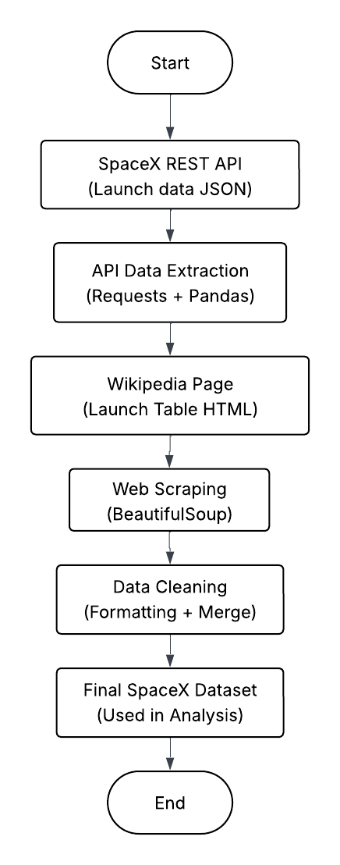
Data Collection
Data was collected using two complementary methods — API extraction and Web Scraping — to ensure data accuracy and completeness.
API Data Collection
Source - SpaceX REST API
Extracted structured JSON data (launches, payloads, sites, outcomes)
Processed using Requests and Pandas
Reliable, real-time, and consistent

Slide 10
Data Collection
Web Scraping
Source: Wikipedia Launch Records
Extracted tabular data using BeautifulSoup
Merged with API data for booster and landing details
Adds missing text fields and cross-verification
Combined Workflow
Merged dataset = API (structured) + Web (descriptive)→ Comprehensive data for SpaceX analysis

Slide 11
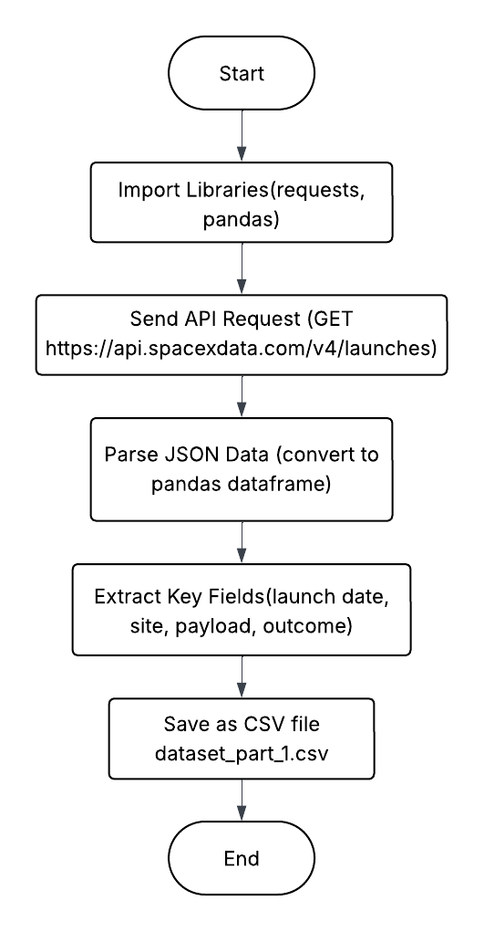
Data Collection – SpaceX API
Data was collected using the official SpaceX REST API, which provides structured JSON data about past and upcoming rocket launches.
Key data fields included:
Flight number, Launch date, and Launch site, Payload mass and orbit type, Rocket booster version, Landing outcome (success/failure/no attempt)
Output: Successfully retrieved launch records from 2010 to 2020.
Generated spacex_launch_data.csv for downstream EDA and SQL tasks.
Github: https://github.com/sreematangi04/IBM-Data-Science-Capstone/blob/main/module%201/jupyter-labs-spacex-data-collection-api.ipynb
Flowchart of
SpaceX API calls

Slide 12
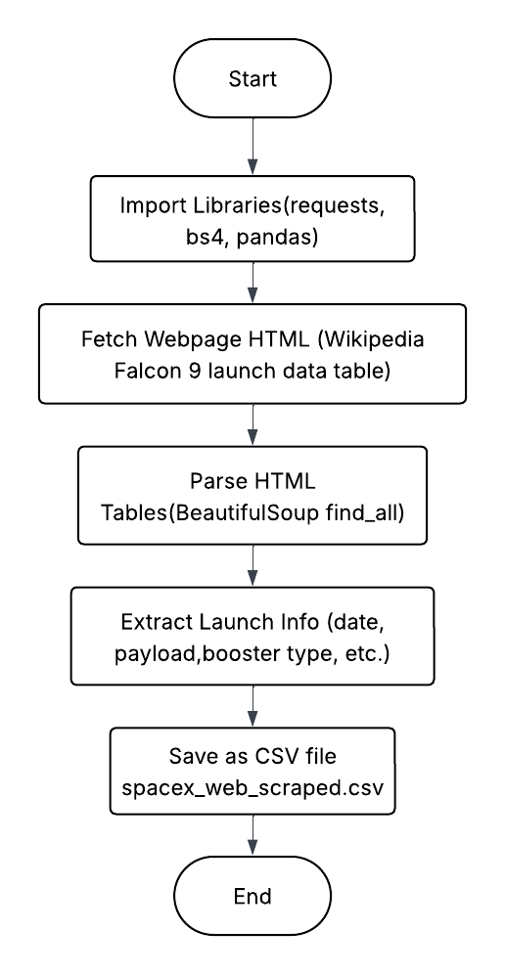
Data Collection - Scraping
For additional details not available in the API (e.g., booster performance metrics and payload manufacturer info), web scraping was performed from Wikipedia’s Falcon 9 launch records using BeautifulSoup and requests.
GitHub: https://github.com/sreematangi04/IBM-Data-Science-Capstone/blob/main/module%201/jupyter-labs-webscraping-bak-2025-10-12-12-00-08Z.ipynb
Flowchart of
web scraping

Slide 13
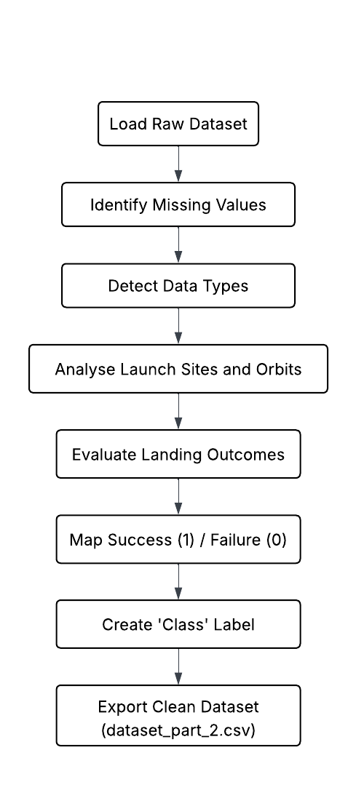
Data Wrangling
Data wrangling involved cleaning, transforming, and merging datasets collected from the SpaceX REST API and Wikipedia (web scraping) to prepare them for analysis and model building.
Key Processing Steps
Data Cleaning: Removed nulls, duplicates, and inconsistent entries.
Data Transformation: Converted dates, standardized column names, and encoded categorical variables.
Feature Engineering: Derived new columns like Launch Year, Landing Status, and binary Class.
Data Integration: Merged API and scraped data on FlightNumber to form a unified dataset.
Validation: Ensured type consistency and verified record counts across merged data.
Github : https://github.com/sreematangi04/IBM-Data-Science-Capstone/blob/main/module%201/labs-jupyter-spacex-Data%20wrangling.ipynb

Slide 14
EDA with Data Visualization
Summarize what charts were plotted and why you used those charts
Add the GitHub URL of your completed EDA with data visualization notebook, as an external reference and peer-review purpose

Slide 15
EDA with SQL
Using bullet point format, summarize the SQL queries you performed
Add the GitHub URL of your completed EDA with SQL notebook, as an external reference and peer-review purpose

Slide 16
Build an Interactive Map with Folium
Summarize what map objects such as markers, circles, lines, etc. you created and added to a folium map
Explain why you added those objects
Add the GitHub URL of your completed interactive map with Folium map, as an external reference and peer-review purpose

Slide 17
Build a Dashboard with Plotly Dash
Summarize what plots/graphs and interactions you have added to a dashboard
Explain why you added those plots and interactions
Add the GitHub URL of your completed Plotly Dash lab, as an external reference and peer-review purpose

Slide 18
Predictive Analysis (Classification)
Summarize how you built, evaluated, improved, and found the best performing classification model
You need present your model development process using key phrases and flowchart
Add the GitHub URL of your completed predictive analysis lab, as an external reference and peer-review purpose

Slide 19
Results
Exploratory data analysis results
Interactive analytics demo in screenshots
Predictive analysis results

Slide 20

Section 2

Slide 21
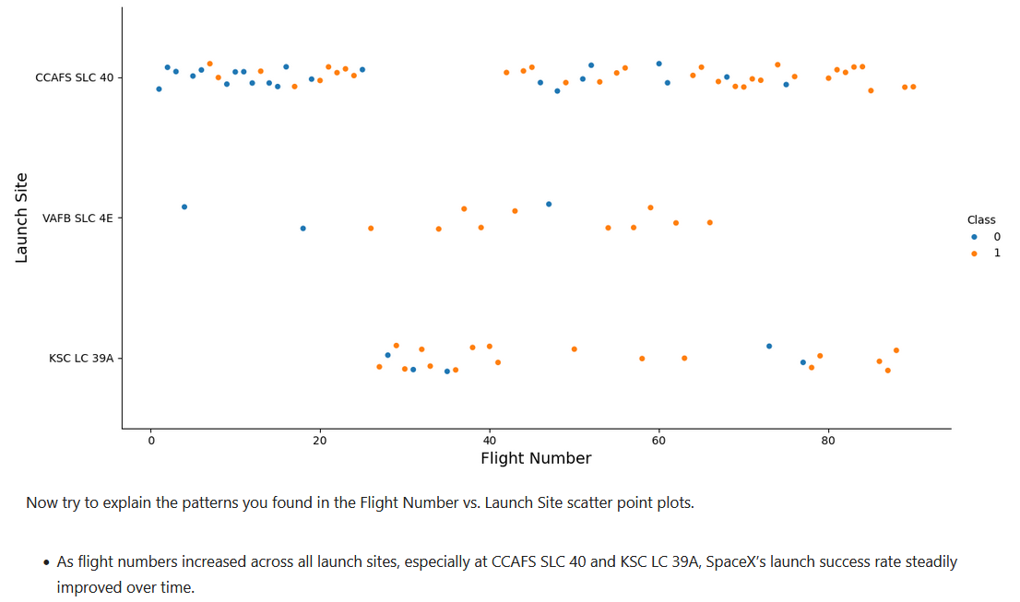
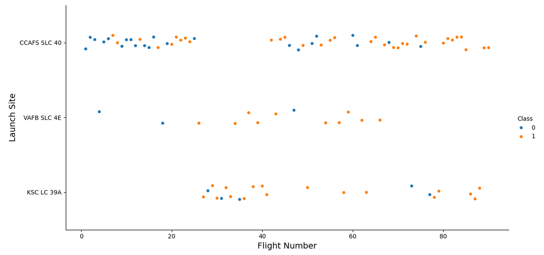
Flight Number vs. Launch Site
Flight Number vs. Launch Site
Scatter plot with explanations

Slide 22
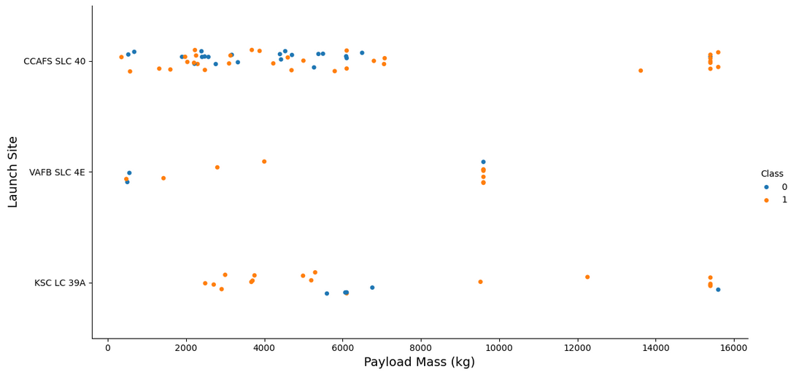
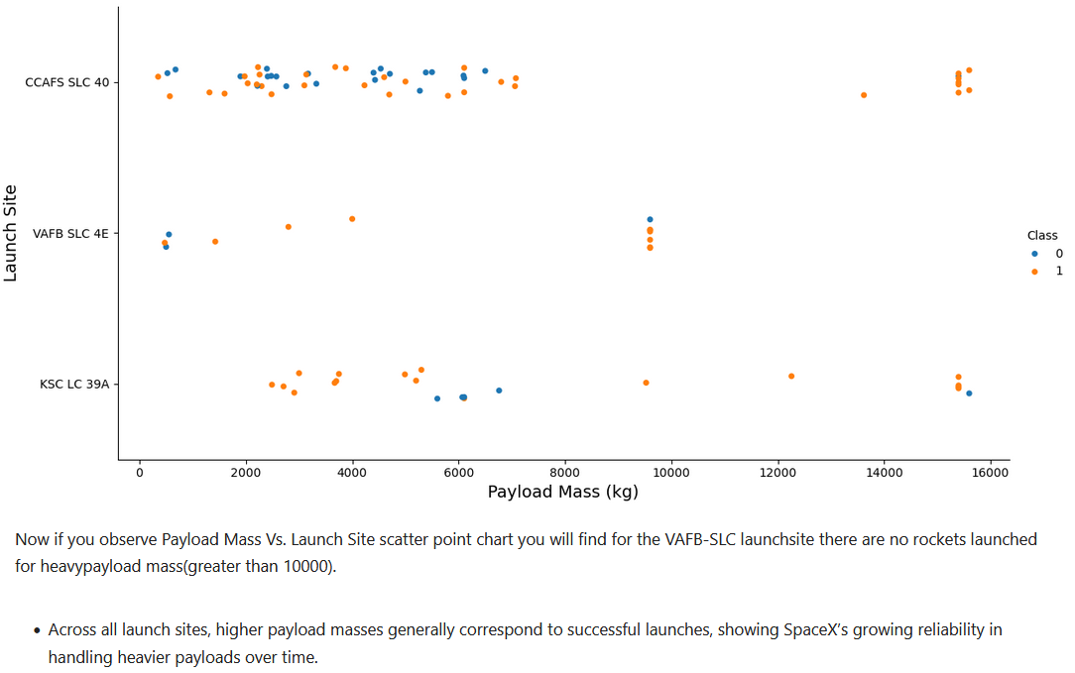
Payload vs. Launch Site
Payload vs. Launch Site
Scatter plot with explanations

Slide 23
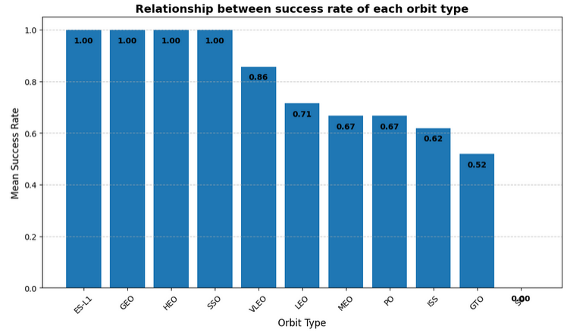
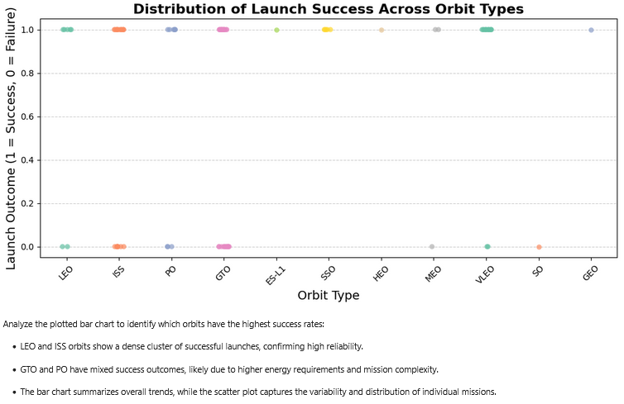
Success Rate vs. Orbit Type
Success rate of each orbit type
Scatter plot with explanations

Slide 24
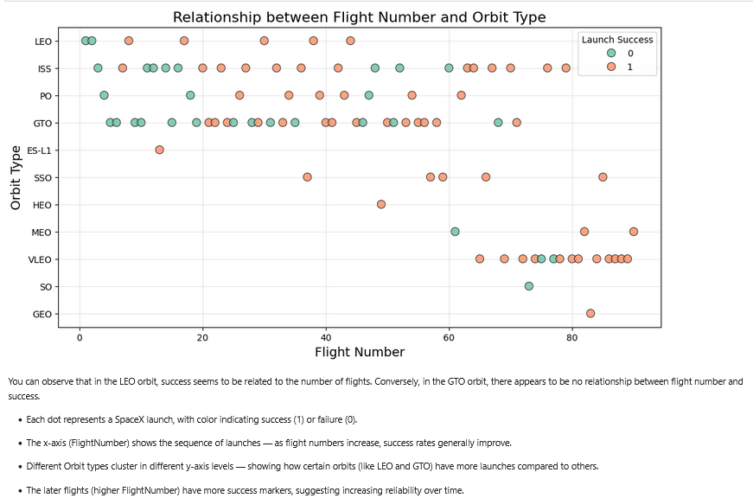
Flight Number vs. Orbit Type
Flight number vs. Orbit type
Scatter plot with explanations

Slide 25
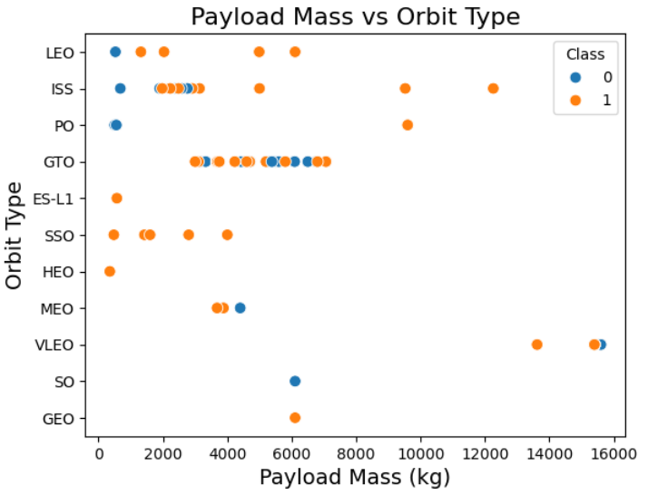
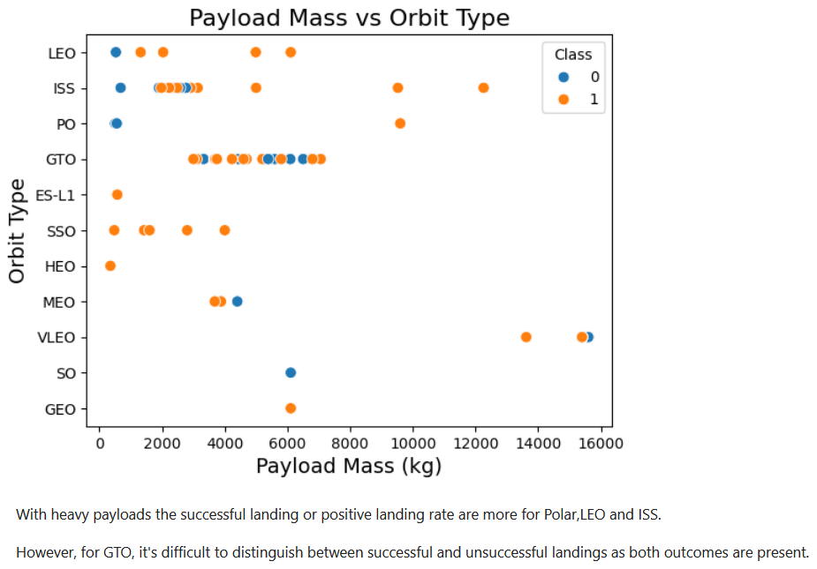
Payload vs. Orbit Type
Payload vs. orbit type
Scatter plot with explanations

Slide 26
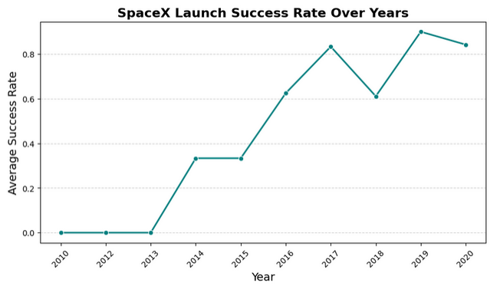
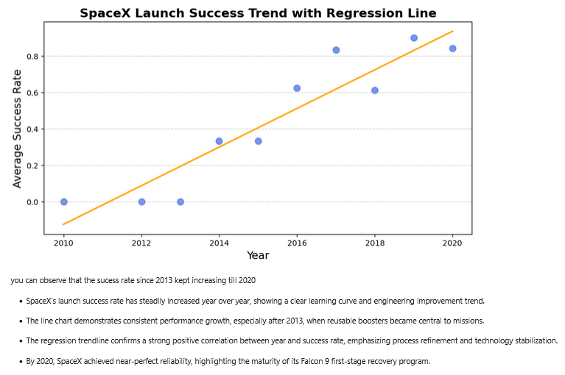
Launch Success Yearly Trend
Line chart of yearly average success rate
Scatter plot with explanations

Slide 27
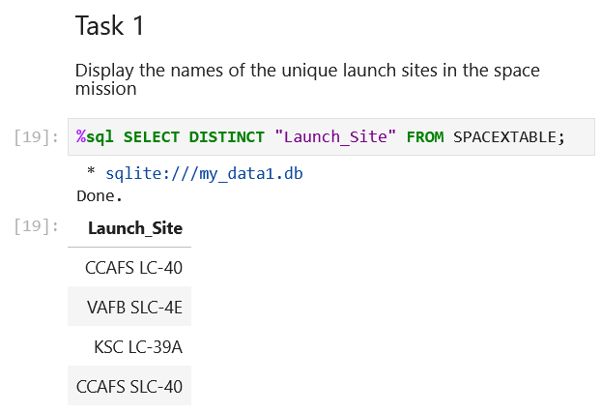
All Launch Site Names
Find the names of the unique launch sites
The query lists all distinct launch sites in the dataset, giving a clear view of where SpaceX missions were launched.

Slide 28
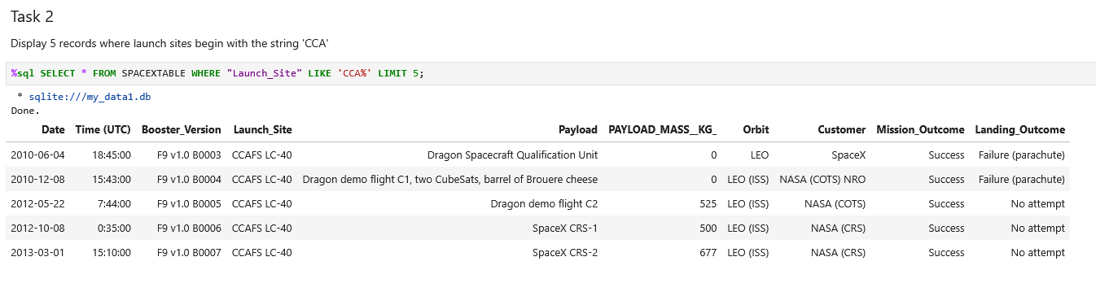
Launch Site Names Begin with 'CCA'
Find 5 records where launch sites begin with `CCA`
This query filters and displays the first five records of launches from sites starting with “CCA”, showing all missions conducted at the Cape Canaveral launch complex.

Slide 29
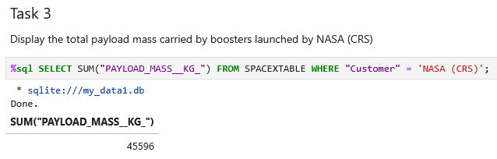
Total Payload Mass
Calculate the total payload carried by boosters from NASA
The query sums up the payload mass for all launches conducted by NASA, giving the total weight of cargo these boosters have carried.

Slide 30
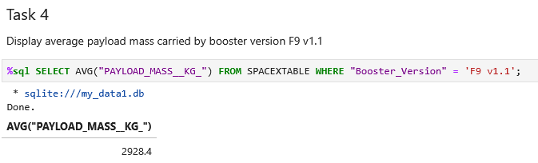
Average Payload Mass by F9 v1.1
Calculate the average payload mass carried by booster version F9 v1.1
The query calculates the average payload mass for all launches using the F9 v1.1 booster version, showing the typical cargo capacity handled by this specific booster.

Slide 31
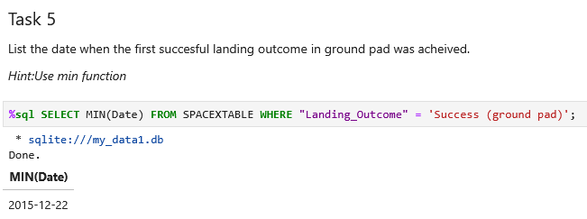
First Successful Ground Landing Date
Find the dates of the first successful landing outcome on the ground pad
The query retrieves the dates of the first successful landings on a ground pad, highlighting when SpaceX achieved a controlled landing on land for the first time.

Slide 32
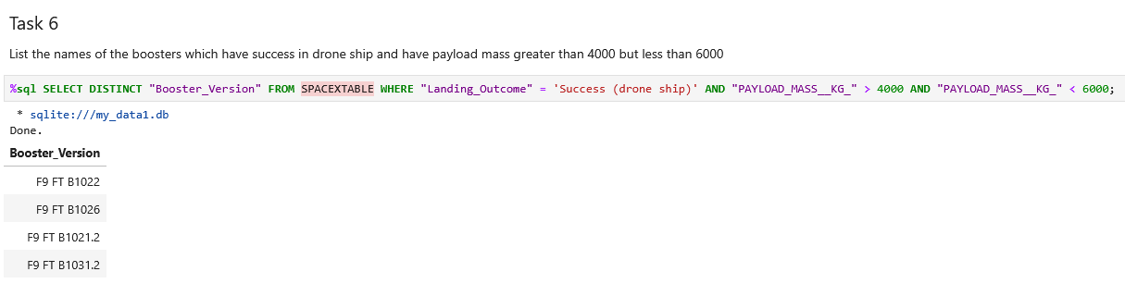
Successful Drone Ship Landing with Payload between 4000 and 6000
List the names of boosters which have successfully landed on a drone ship and had a payload mass greater than 4000 but less than 6000
The query identifies booster names that successfully landed on a drone ship while carrying a payload between 4000 kg and 6000 kg, showing which rockets handled mid-heavy payloads and still achieved a successful sea landing.

Slide 33
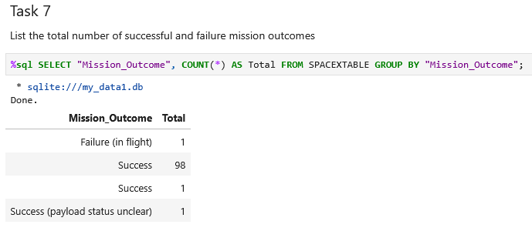
Total Number of Successful and Failure Mission Outcomes
Calculate the total number of successful and failure mission outcomes
The query counts the number of successful versus failed missions, providing a clear overview of SpaceX’s overall mission performance and success ratio across all recorded launches.

Slide 34
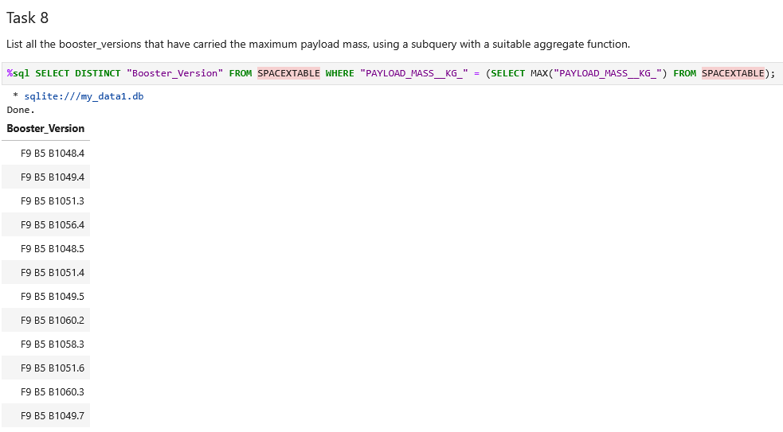
Boosters Carried Maximum Payload
List the names of the boosters which have carried the maximum payload mass
This query identifies the booster(s) that carried the heaviest payload mass, highlighting the most powerful launch vehicles in SpaceX’s fleet based on their payload capacity.

Slide 35
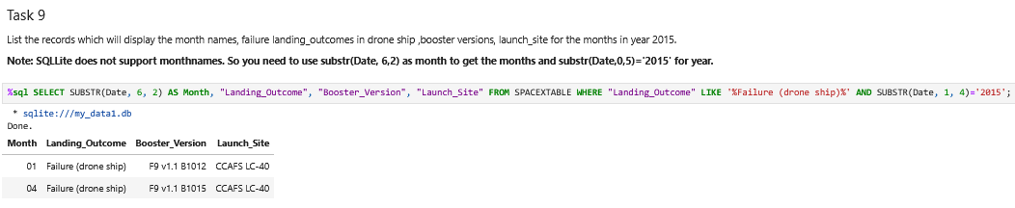
2015 Launch Records
List the failed landing_outcomes in the drone ship, their booster versions, and launch site names for in year 2015
This query filters failed drone ship landings from the year 2015, listing the landing outcomes, booster versions, and launch site names. It helps analyze early mission challenges faced by SpaceX in perfecting drone ship landings during that period.

Slide 36
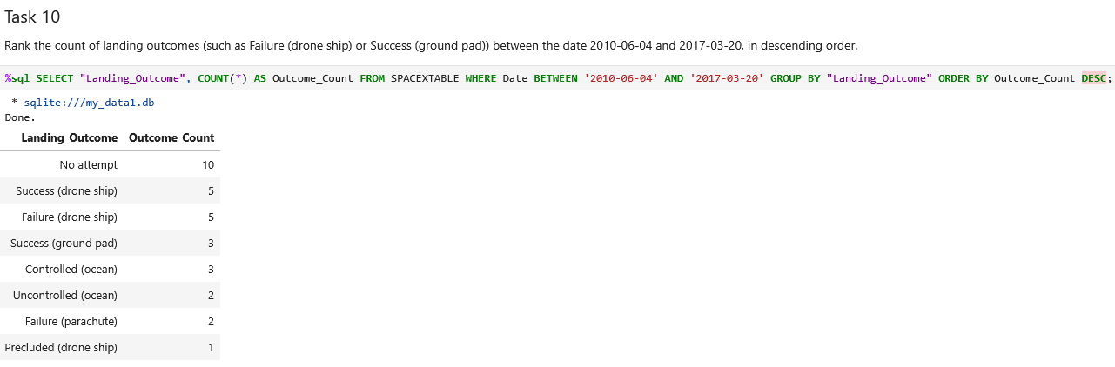
Rank Landing Outcomes Between 2010-06-04 and 2017-03-20
Rank the count of landing outcomes (such as Failure (drone ship) or Success (ground pad)) between the dates 2010-06-04 and 2017-03-20, in descending order
This query ranks landing outcomes between 2010–2017 in descending order, showing which outcomes occurred most frequently during SpaceX’s early missions.

Slide 37

Section 3

Slide 38
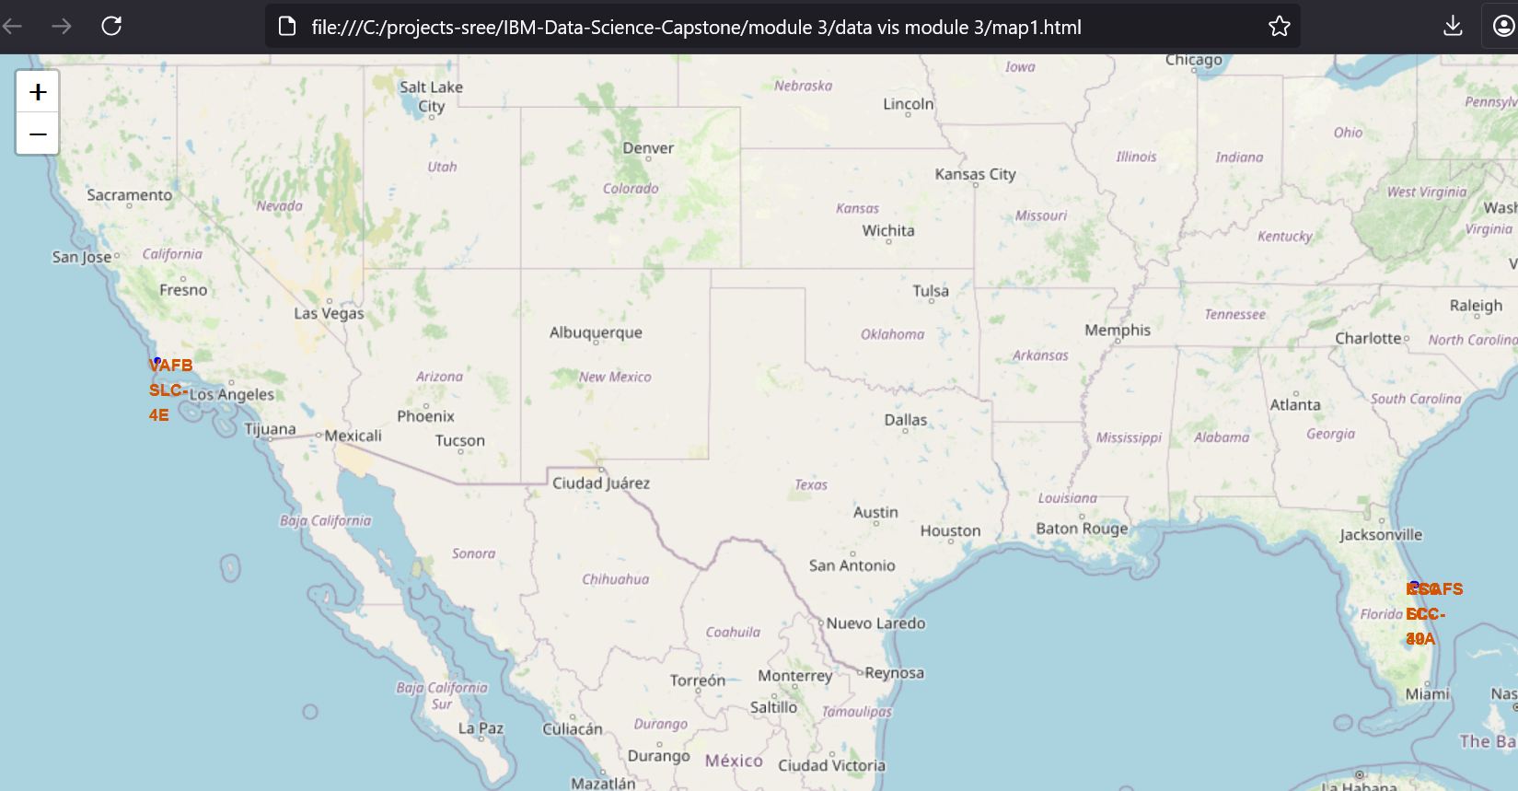
Mark All Launch Sites on Map
Process:
Loaded spacex_launch_geo.csv.
Created an interactive Folium map centered at NASA JSC.
Added circle markers and labels for each launch site.
Findings:
Four main launch sites across the U.S.
Most sites located in Florida and California for optimal launch paths over the Atlantic.

Slide 39
Mark Success/Failed Launches on Map
Process:
Added a new column marker_color → green for success, red for failure.
Used Folium MarkerCluster to group overlapping launch points.
Each marker includes a launch site and an outcome pop-up.
Findings:
Clear visual trend of higher success density at Cape Canaveral and KSC.
Clustering highlights frequent launches from primary sites.

Slide 40
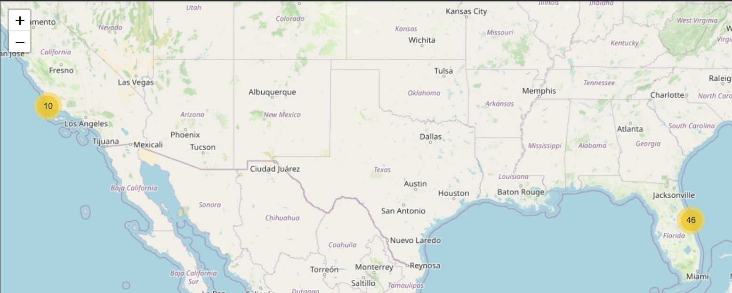
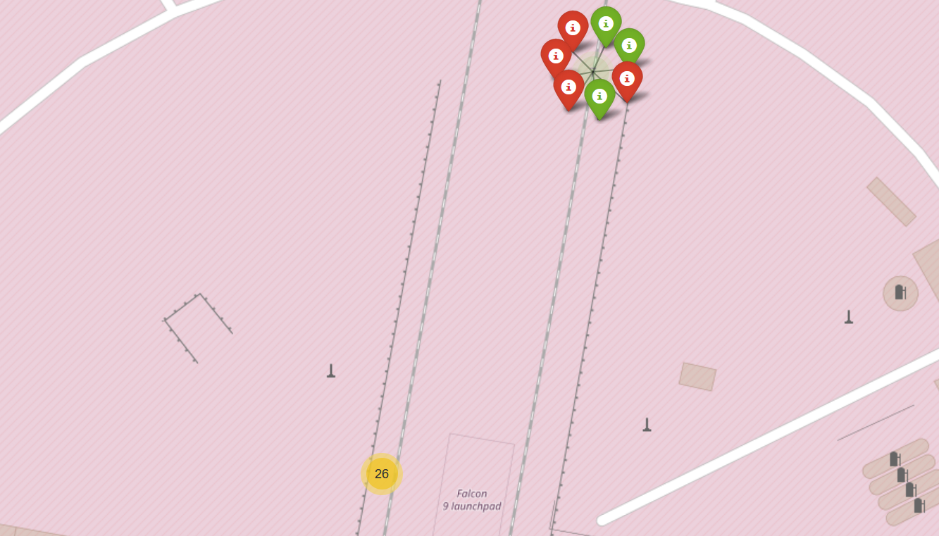
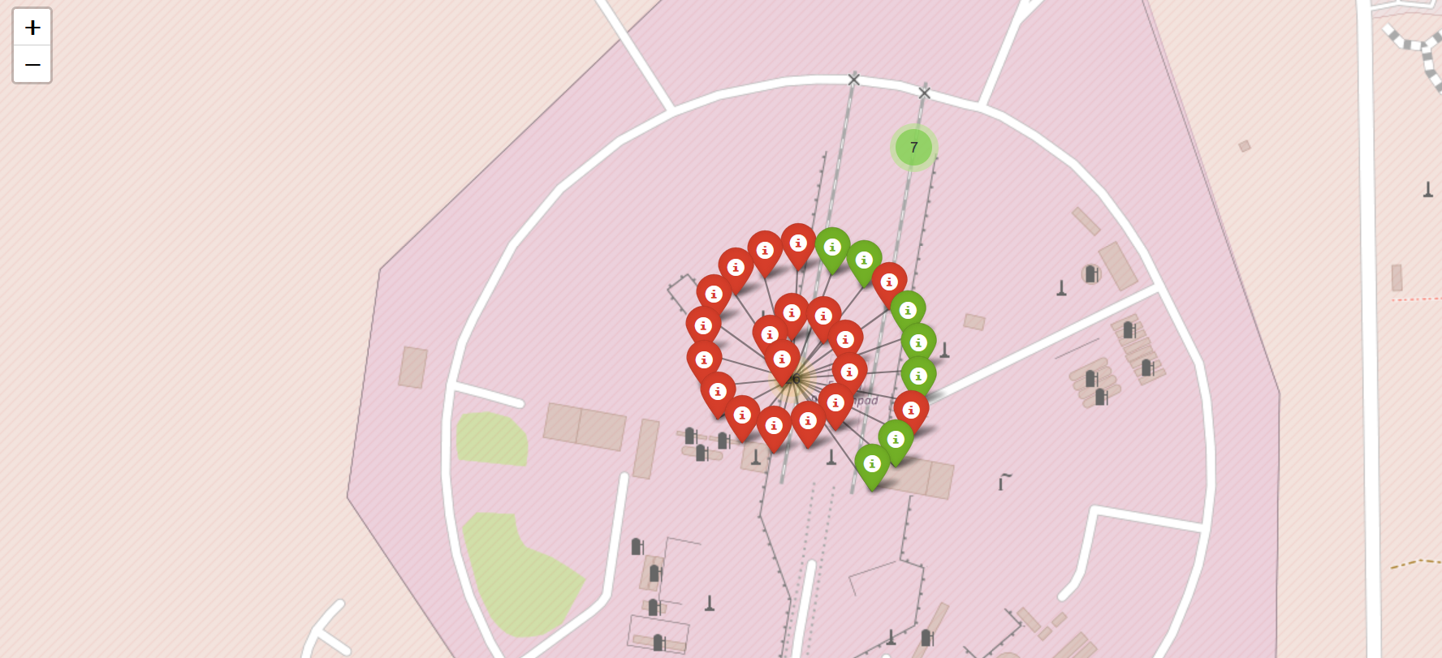
Mark Success/Failed Launches on Map

Slide 41
Calculate Distances to Nearby Features
Process:
Enabled MousePosition tool in Folium to extract coordinates interactively.
Used Haversine formula to compute distances (in km).
Drew PolyLines and labeled distance markers between launch sites and nearby features.
Findings:
All launch sites are very close to coastlines, ideal for over-ocean launches.
Sites maintain moderate distance from cities — ensuring safety during takeoff.
Highways and railways are in close proximity, improving logistics and transport accessibility.

Slide 42
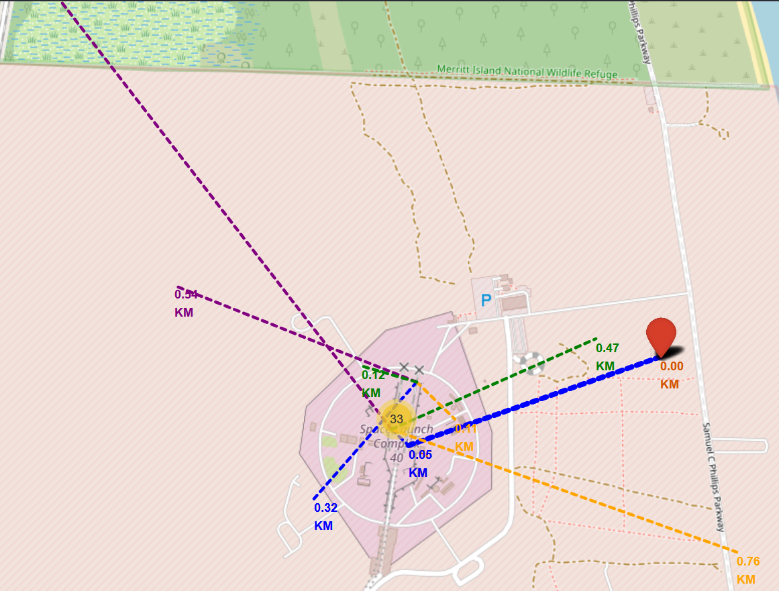
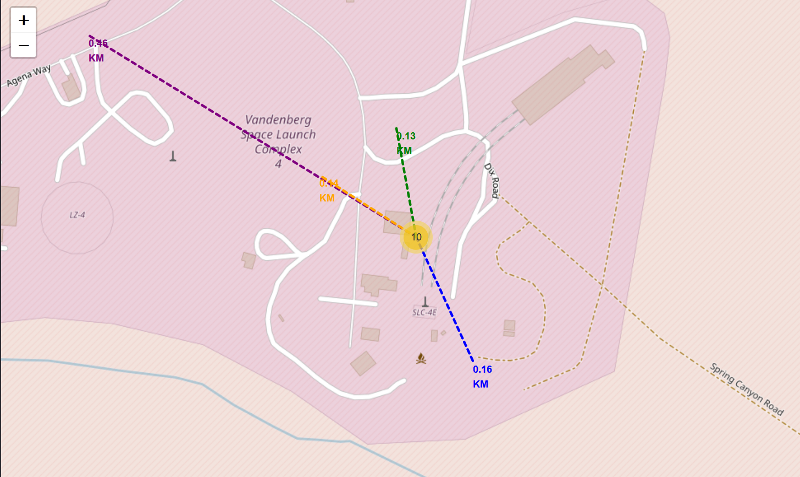
Calculate Distances to Nearby Features

Slide 43

Section 4

Slide 44
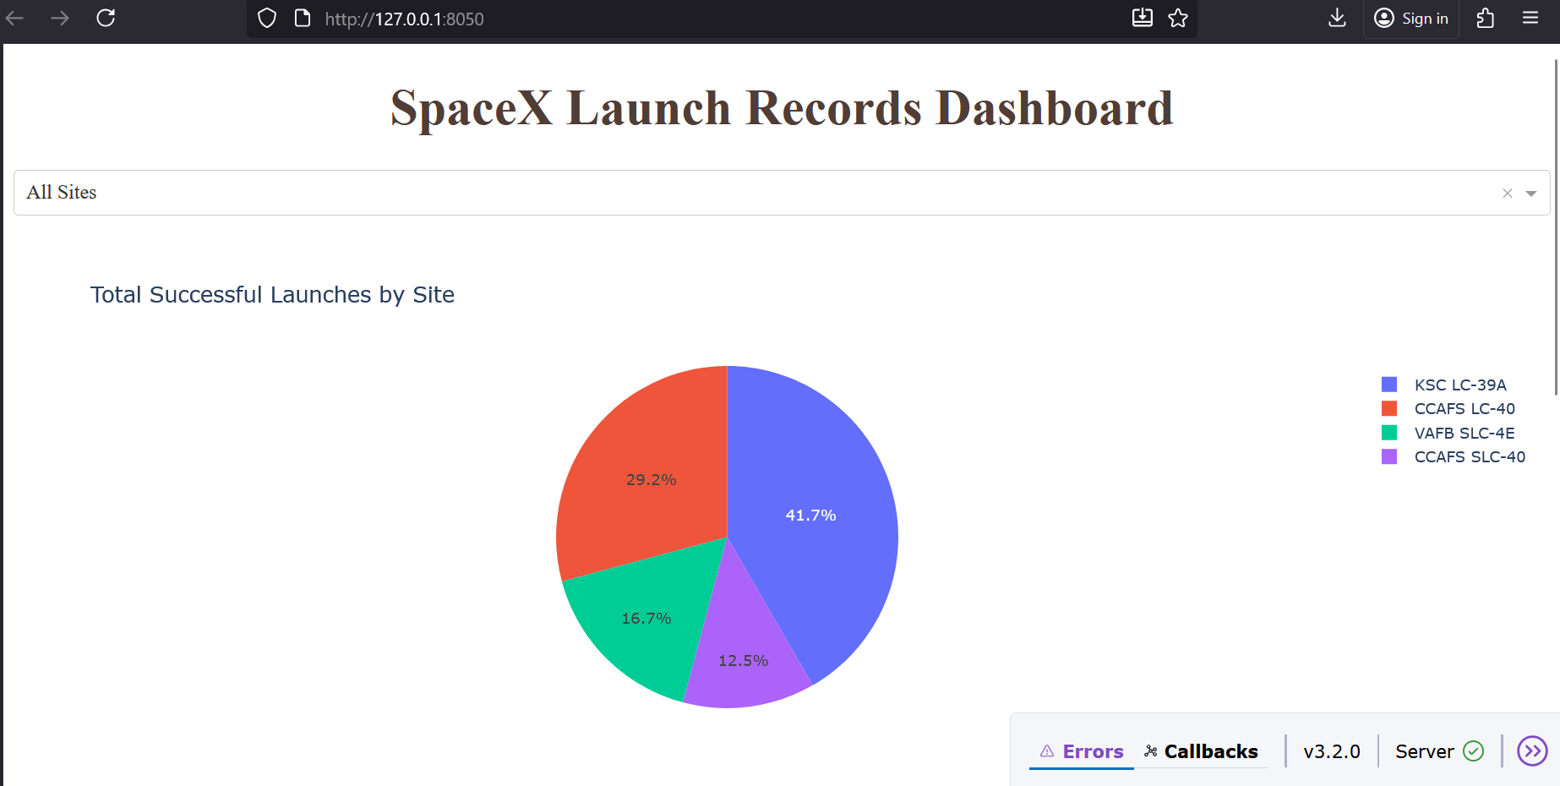
Total Successful Launches by Site
Pie chart shows successful launches per site.
KSC LC-39A leads with the most successes.
Other sites have fewer launches.
Overall, SpaceX shows high success reliability.

Slide 45
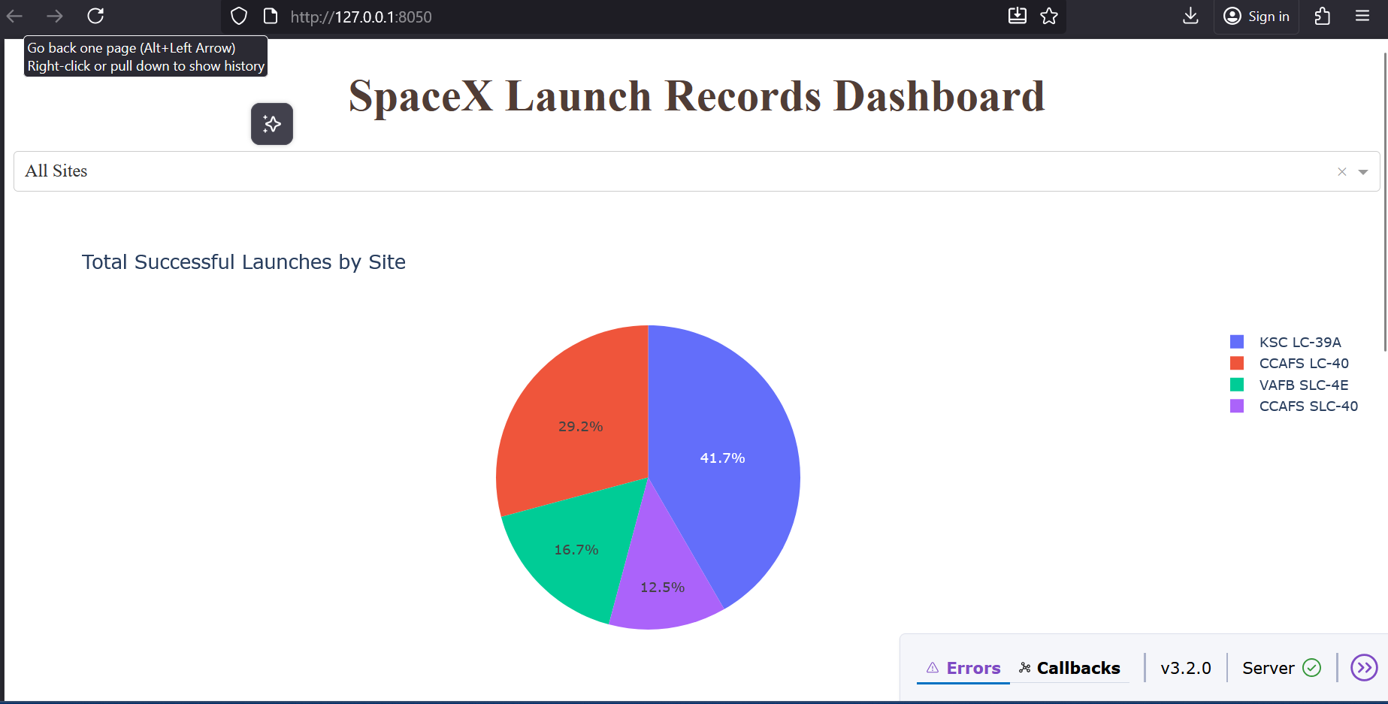
Highest Launch Success Ratio
Highest Launch Success Ratio – KSC LC-39A (Pie Chart)
The blue section (41.7%) in the pie chart represents the successful launches from KSC LC-39A.
This high proportion highlights that KSC LC-39A has the highest launch success ratio among all sites.

Slide 46
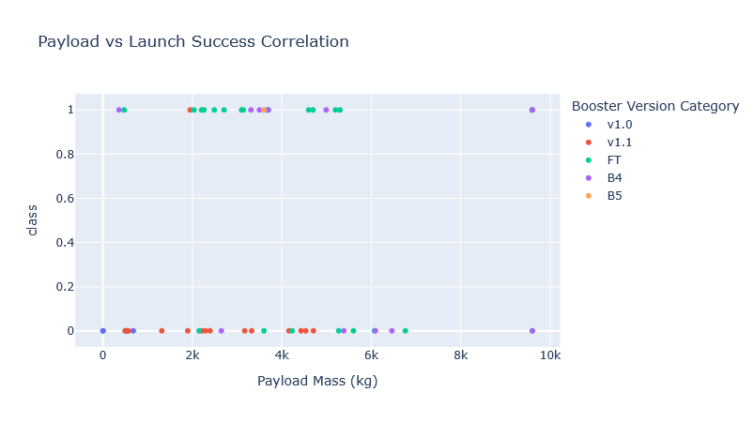
Payload vs. Launch Outcome Scatter Plot (All Sites)
The scatter plot shows launch outcomes (success or failure) against payload mass for all launch sites.
Successful launches are marked distinctly (green), while failures are marked in red.
Observations from the plot:
Payloads in the low-to-mid range show a higher concentration of successful launches.
Certain heavier payloads occasionally fail, indicating more risk with high-mass missions.
By selecting different payload ranges using the range slider, we can analyse booster performance for specific payload classes.
Some booster versions consistently show high success rates across multiple payload ranges.

Slide 47

Section 5

Slide 48
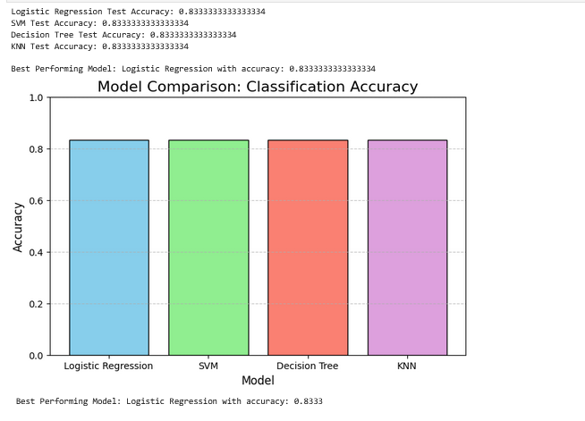
Classification Accuracy
Visualization of the built model accuracy for all built classification models, in a bar chart
To Find which model has the highest classification accuracy

Slide 49
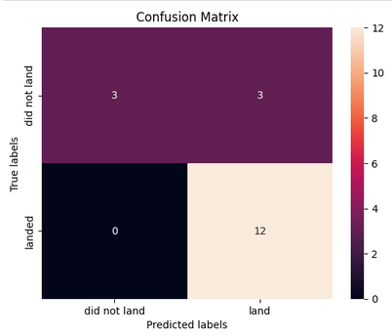
Confusion Matrix
Confusion matrix of the best performing model with an explanation

Slide 50
Conclusions
Point 1
Point 2
Point 3
Point 4
…

Slide 51
Appendix
Include any relevant assets like Python code snippets, SQL queries, charts, Notebook outputs, or data sets that you may have created during this project

Slide 52


